Slide 1
THE FIFA BALLON D’OR
VOTING APP
A JAVA APPLICATION FOR PC
Developed & Presented By –
Naimur Rahman
Roll – 1907031
Department – CSE
Year – 2nd
Semester – 2nd
Session – 2020-21

Slide 2
OBJECTIVES:
To develop an efficient and effective voting app
To create a detailed control panel for an admin as possible
To execute a more modern style of viewing data in JAVA Apps
To add extra smaller details in the development
To create an easier and user friendly UI

Slide 3
MAIN GOAL:
Develop an app for any type of votes. That being –
Normal polls
Opinions
Elections
Research data collection
Reviews
Here, a particular approach is taken to develop a voting app for one of the most anticipated votes in a calendar year – “The FIFA Ballon D’OR”

Slide 4
INTRODUCTION TO THE CONCEPT:
Nominees (usually 30) are the best football players in a calendar year based on individual & team performances
A voter (usually consists of captains & coaches of national teams & selected journalists) has 3 voting options that can be given to 3 different players –
5 Point Vote
3 Point Vote
1 Point Vote
The rank is based on getting the most points
If multiple players have the same amount of points, they are given the same rank

Slide 5
FEATURES IMPLEMENTED:
Object Oriented Programming
JAVA Swing GUI
Threading
MySQL Database (Insert, Update, Delete, View & Search)
User Login
Player Data
Admin Control
Result Set

Slide 6
APP SECTIONS:
The App can be sub-divided into 4 different sections –
Home Interface
Admin Interface
User/Voter Interface
Result Interface

Slide 7
HOME INTERFACE:
The Home Interface consists of the following –
Title Page
User Login Page
User Registration Page
Admin Login Page

Slide 8

TITLE PAGE:
App Title
Loading Percentage
Progress Bar
Key Feature:
Usage of “Threading” to implement The Percentage Number & Progress Bar

Slide 9
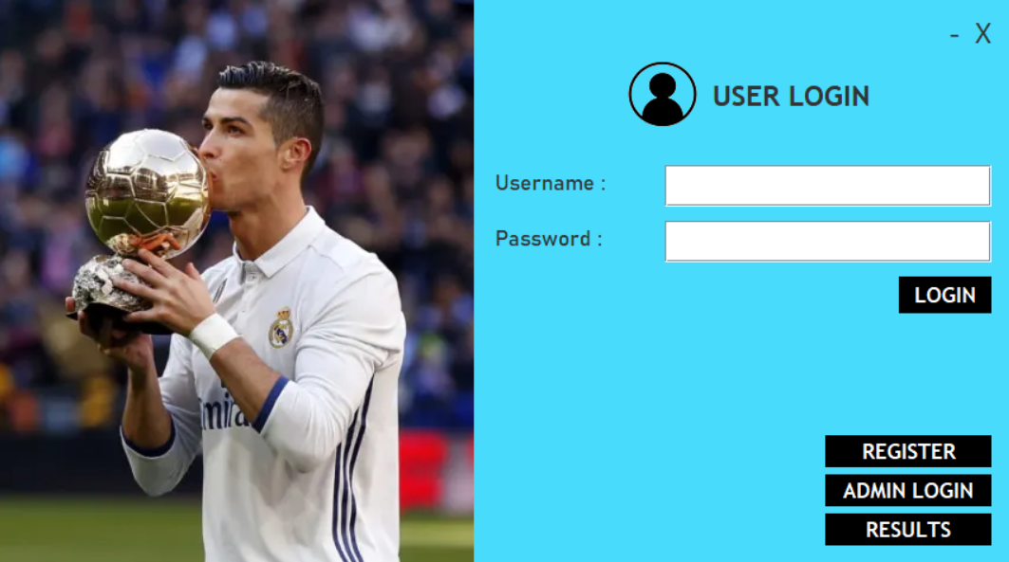
USER LOGIN PAGE:
Minimize & Close Button
Login Button
Register Page Redirect
Admin Login Redirect
Results Page Redirect
Key Feature:
Data Reading form MySQL Server (User Login)

Slide 10
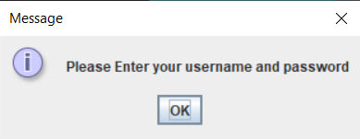
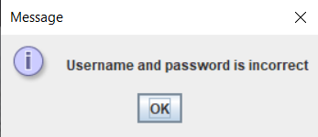
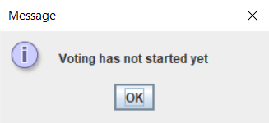
USER LOGIN PAGE (SPECIAL CASES):
1
2
3
If any field is empty
If username or password doesn’t exist or incorrect
If Admin has paused or not started the vote yet

Slide 11
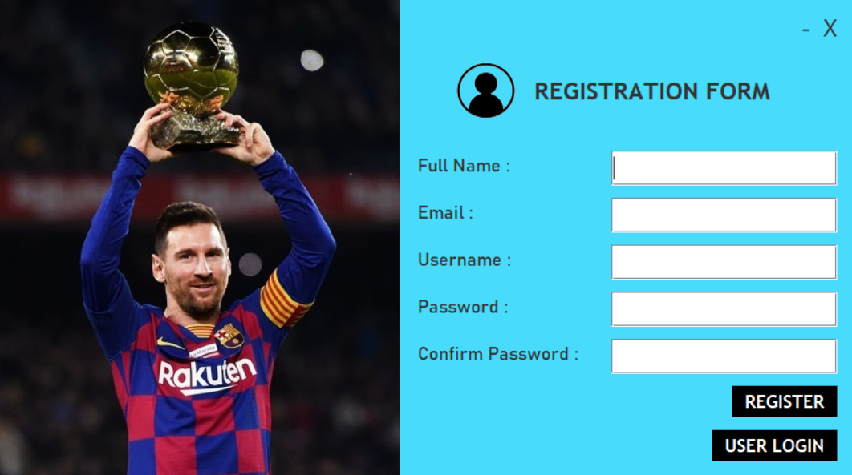
USER REGISTRATION PAGE:
Register Button
User Login Redirect
Key Feature:
Data Inserting into MySQL Server (User Login)

Slide 12
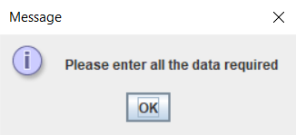
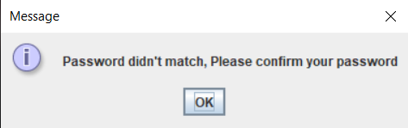
USER REGISTRATION PAGE (SPECIAL CASES):
1
2
If any field is empty
If Password & Confirm Password fields don’t match

Slide 13
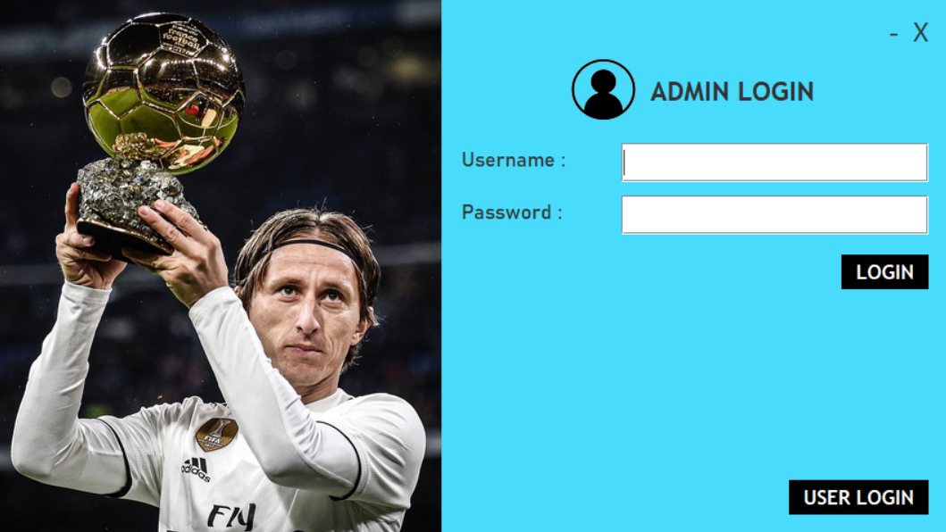
ADMIN LOGIN PAGE:
Login Button
User Login Redirect
Key Feature:
Username & Password for Admin is embedded within code to increase efficiency as there are limited number of Admins and thus Database is not required

Slide 14
ADMIN LOGIN PAGE (SPECIAL CASES):
1
2
If any field is empty
If username or password doesn’t exist or incorrect

Slide 15
ADMIN INTERFACE:
The Admin Interface consists of the following –
Add New Player
Update Existing Player
Delete Existing Player
View Existing Players
Vote & Result Control Interface

Slide 16
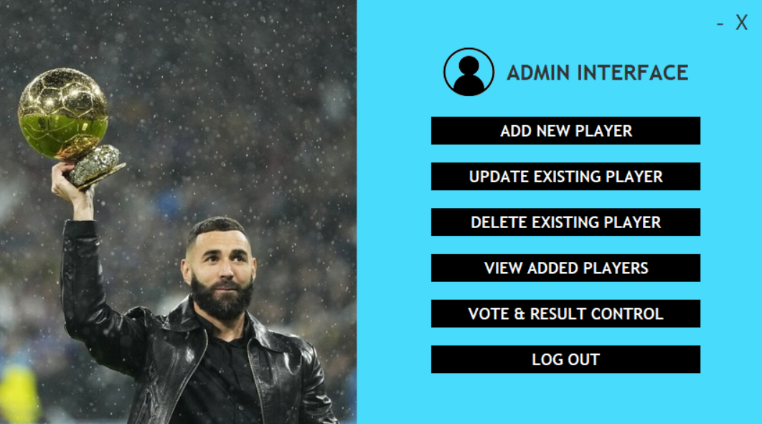
ADMIN INTERFACE:
Admin Login Redirect

Slide 17
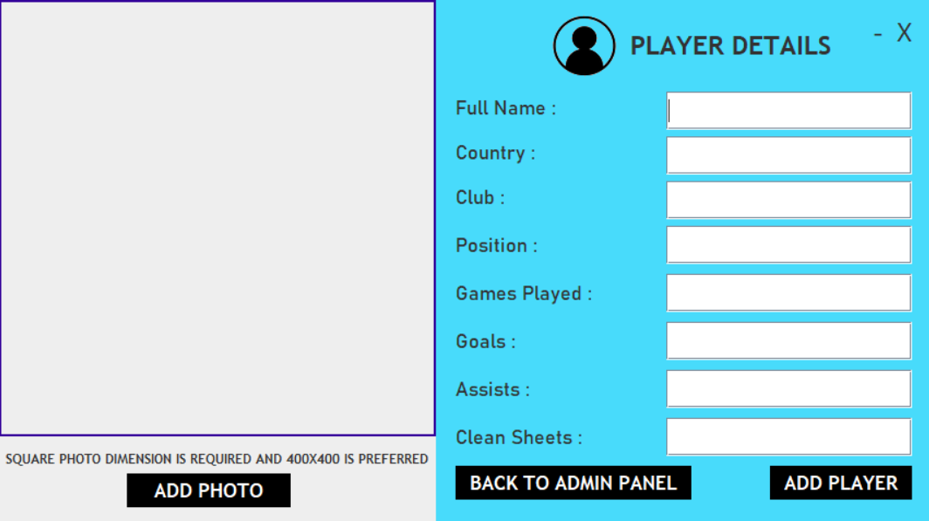
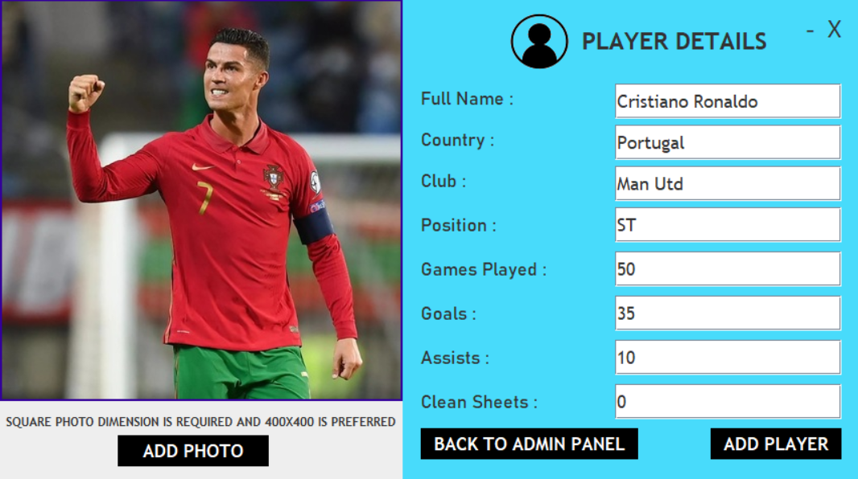
ADD NEW PLAYER:
Key Feature:
Data Inserting into MySQL Server (Player Data)

Slide 18
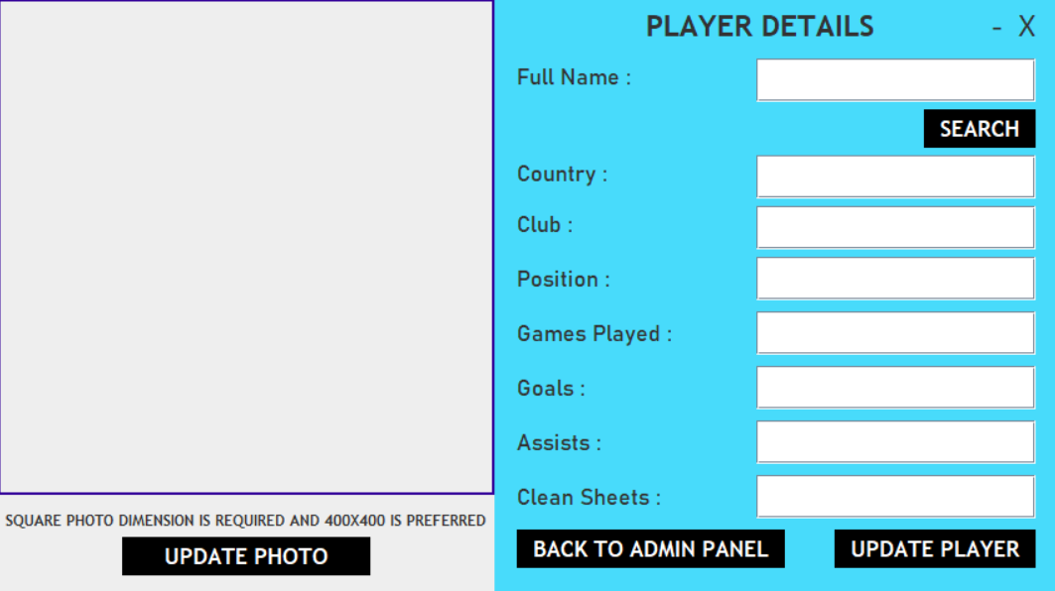

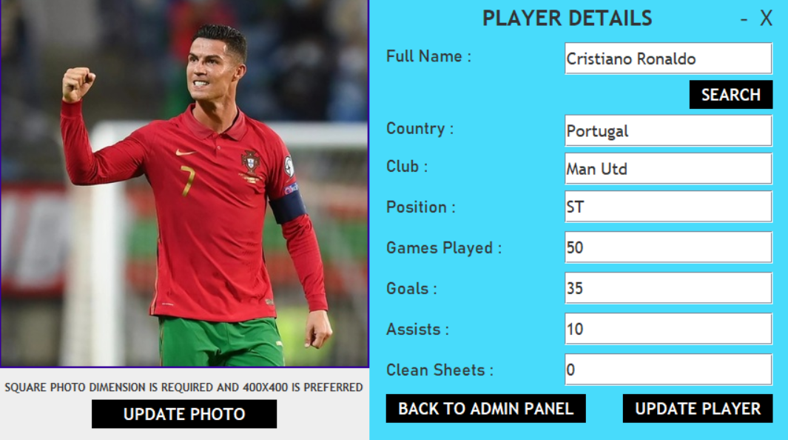

UPDATE EXISTING PLAYER:

Slide 19
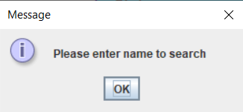
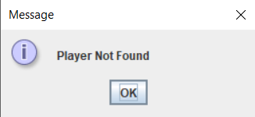
UPDATE EXISTING PLAYER:
Key Features:
Data Searching from MySQL Server (Player Data)
Data Updating into MySQL Server (Player Data)

Slide 20
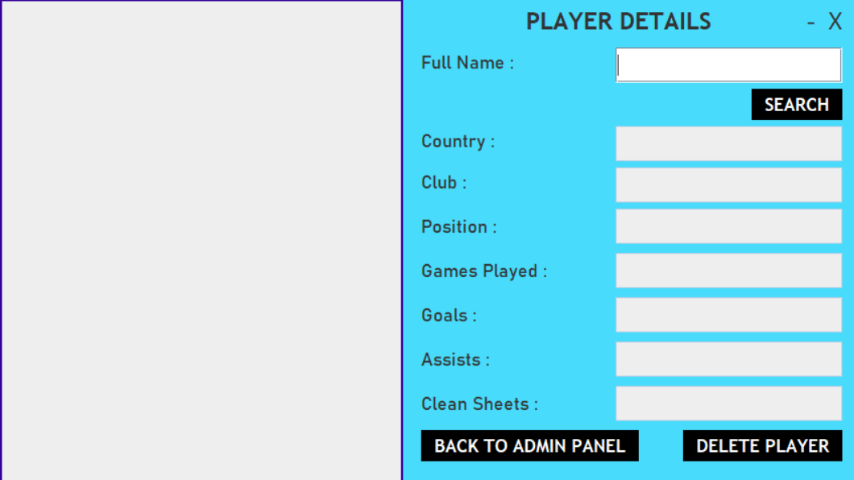
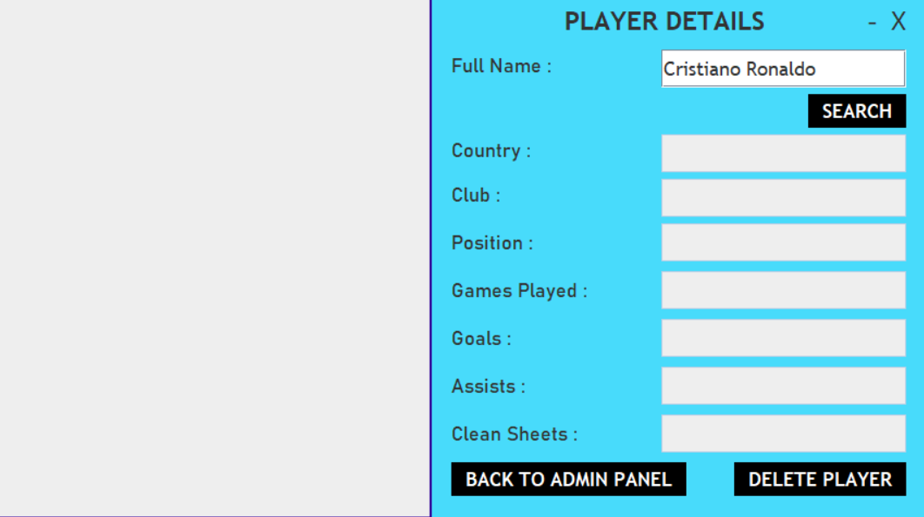
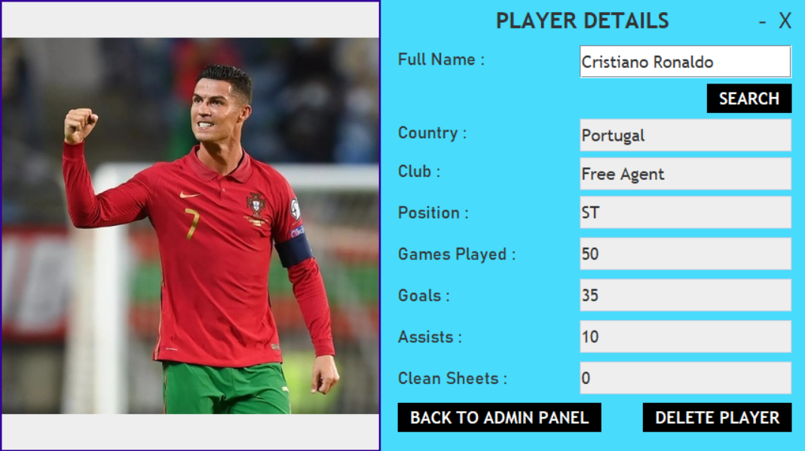
DELETE EXISTING PLAYER:

Slide 21
DELETE EXISTING PLAYER:
Key Features:
Data Searching from MySQL Server (Player Data)
Data Deleting from MySQL Server (Player Data)

Slide 22
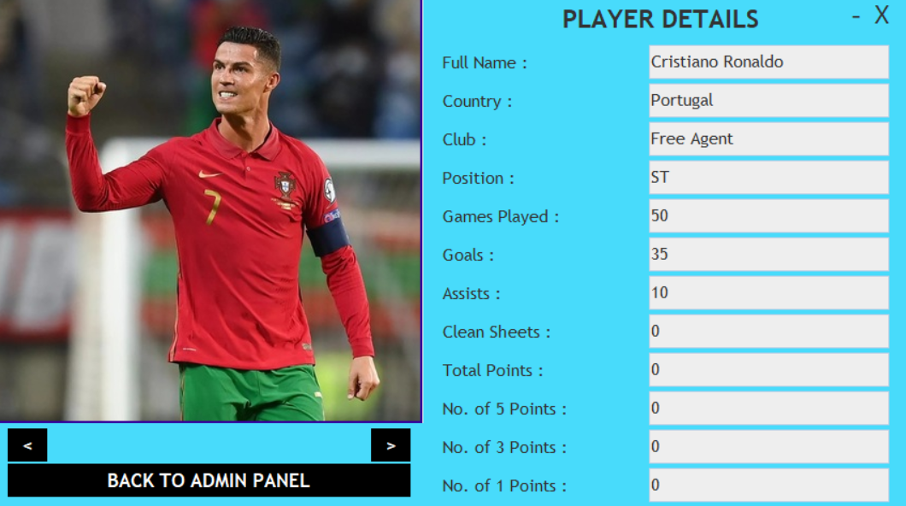
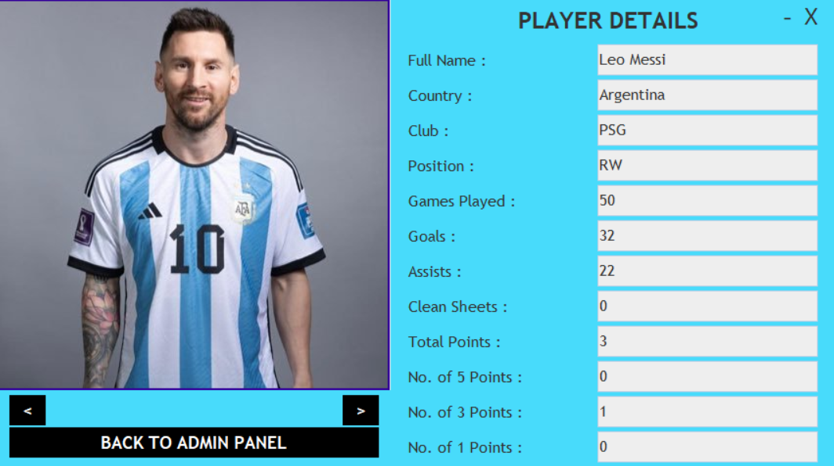
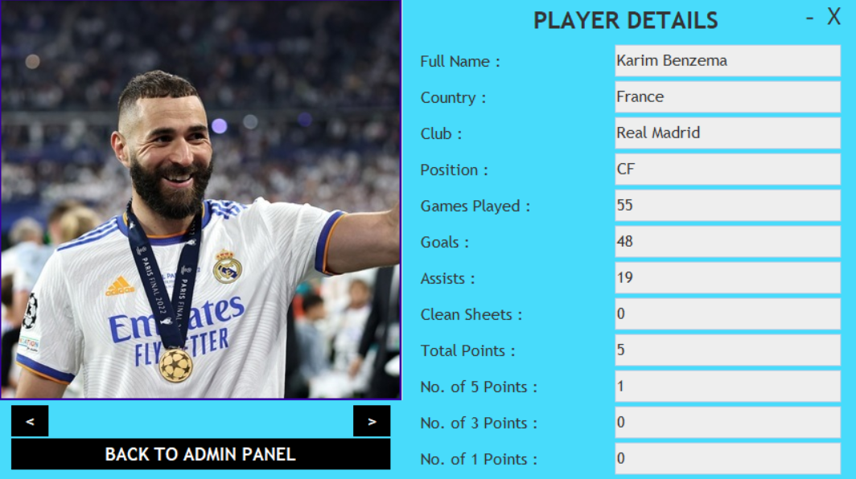
VIEW EXISTING PLAYERS:

Slide 23
VIEW EXISTING PLAYERS:
Special Features:
Swipe Style Viewing System
More Modern Style of Viewing rather than Traditional Tabular View
Key Feature:
Data Viewing from MySQL Server (Player Data)

Slide 24
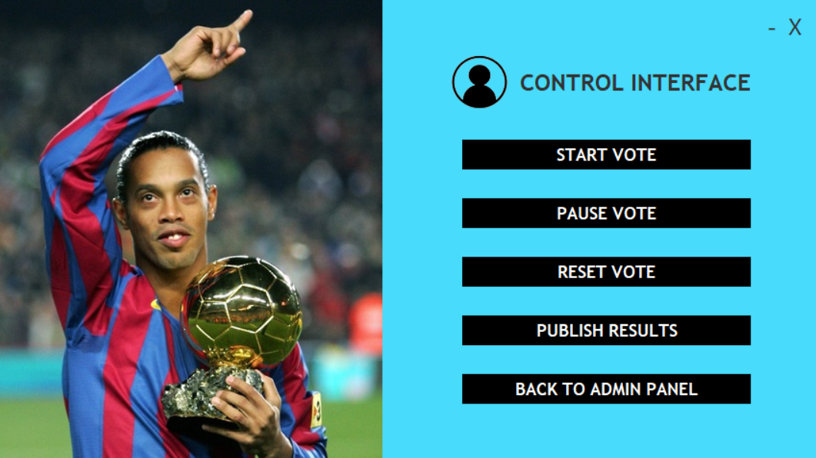
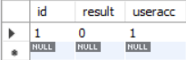
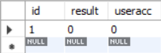
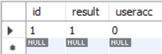
VOTE & RESULT CONTROL INTERFACE:
Admin
Control
Key Feature:
Data Updating & Deleting within MySQL Server (User Login, Player Data & Admin Control)

Slide 25
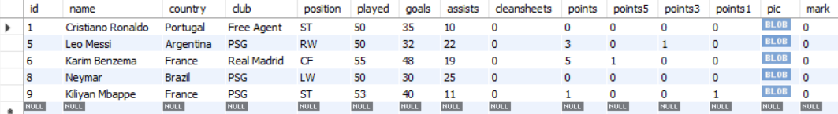
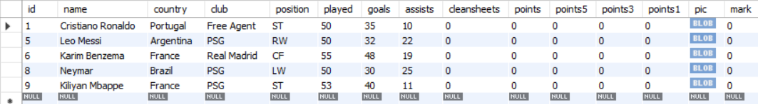
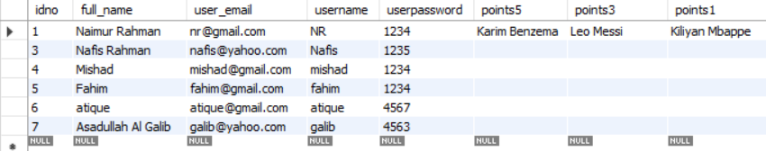
RESET VOTE:
Player
Data
User
Login

Slide 26
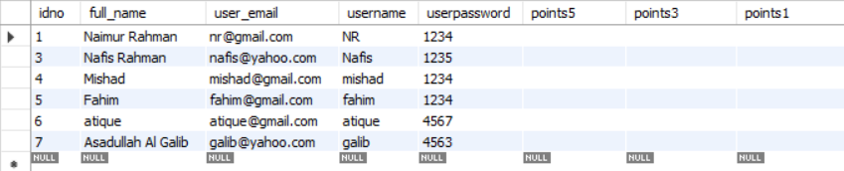
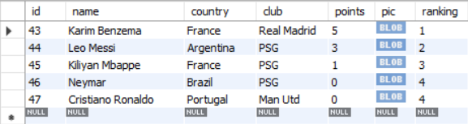
RESET VOTE:
User
Login
Result
Set

Slide 27
USER INTERFACE:
The User Interface consists of the following –
5 Points Vote
3 Points Vote
1 Points Vote
View Nominees

Slide 28
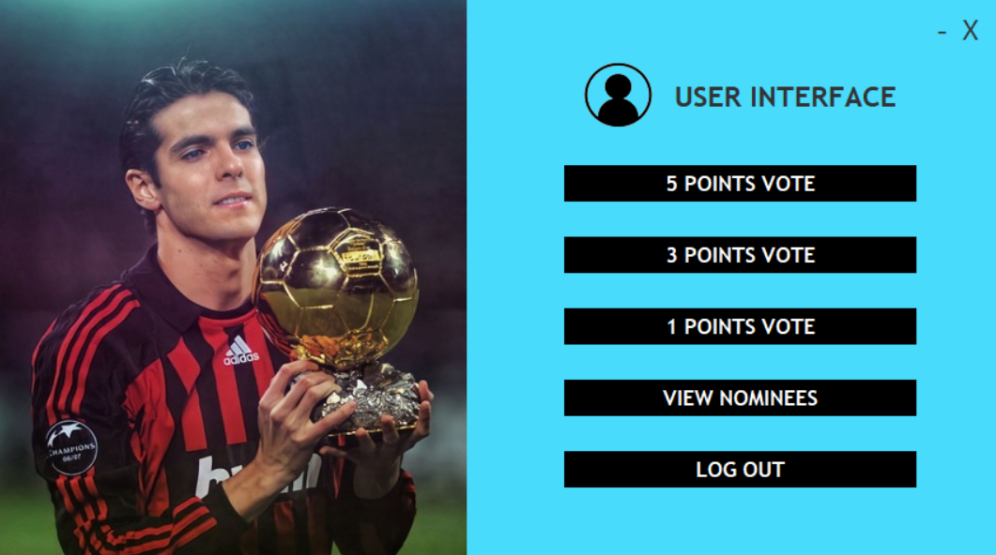
USER INTERFACE:
User Login Redirect

Slide 29
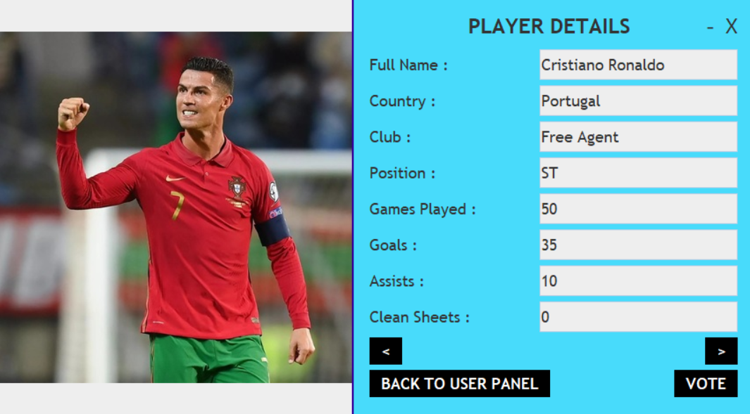
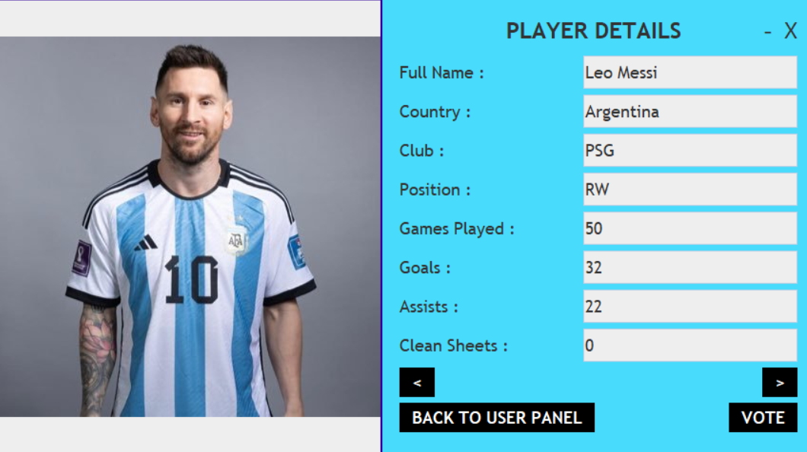
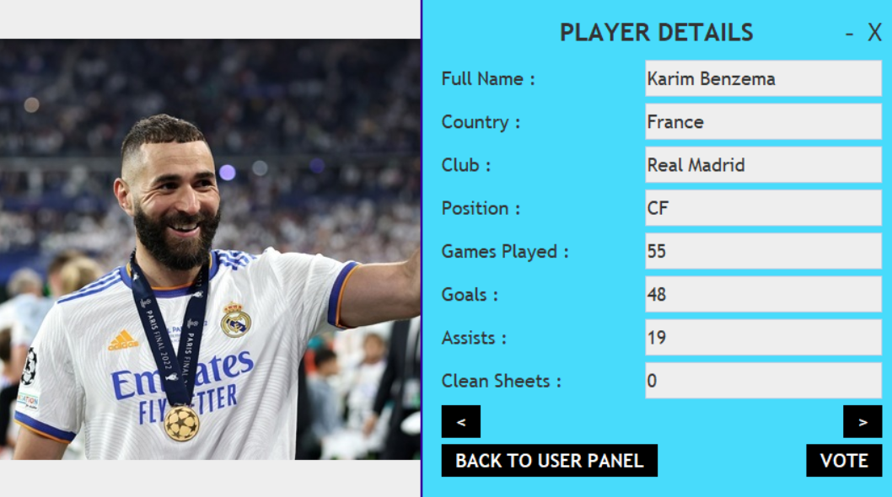
5/3/1 POINTS VOTE:

Slide 30
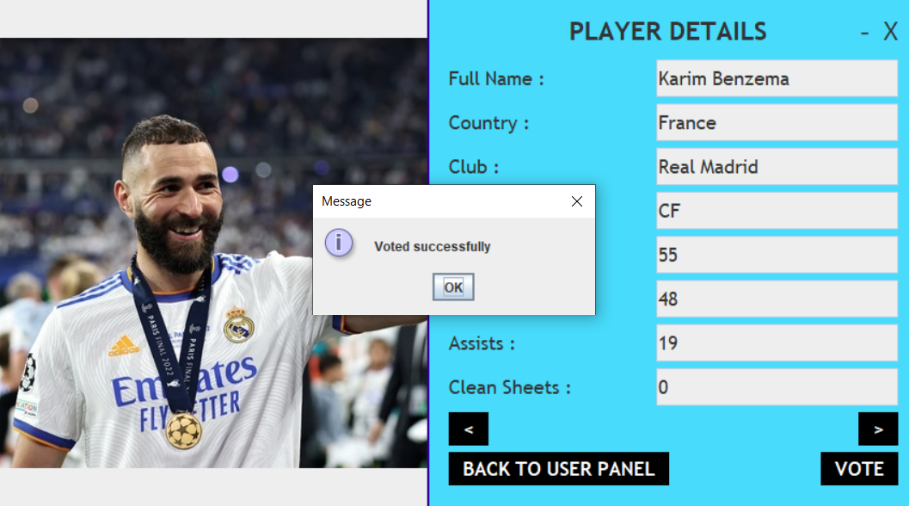
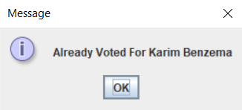
5/3/1 POINTS VOTE:
Key Features:
Data Updating into MySQL Server (Player Data & User Login)

Slide 31
5/3/1 POINTS VOTE:
Player Data
User Login
Key Point:
Each Vote must be assigned to “A Different Player”

Slide 32
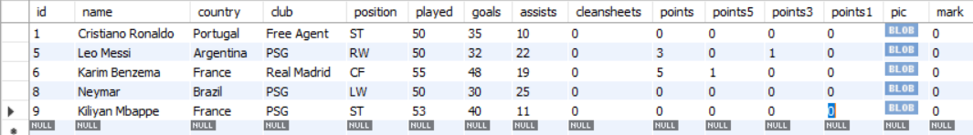
5/3/1 POINTS VOTE:
User Login
Player Data
Key Point:
Players that are Already Voted for by The Particular User will Not Be Shown for The Next Vote

Slide 33
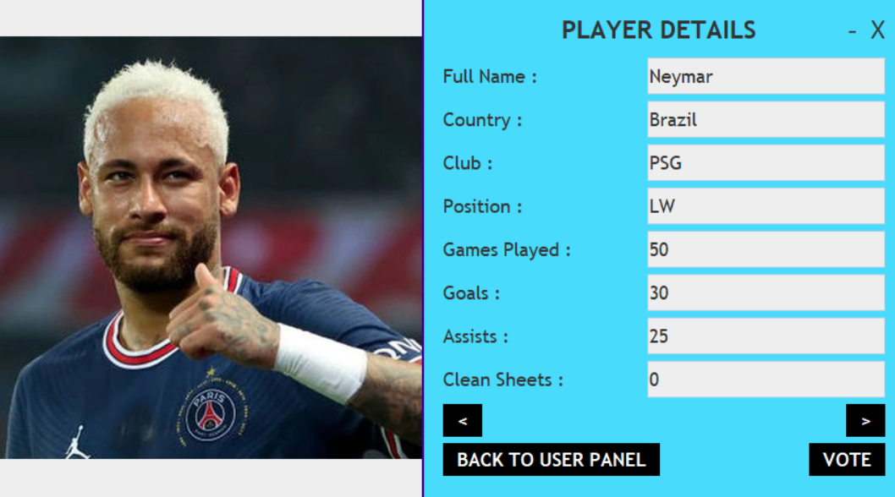
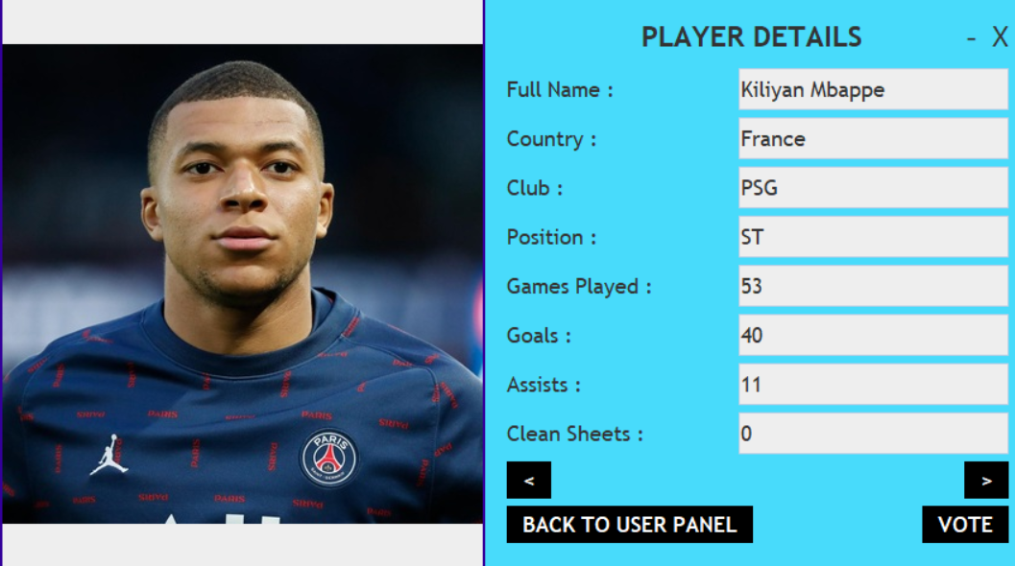
5/3/1 POINTS VOTE:

Slide 34
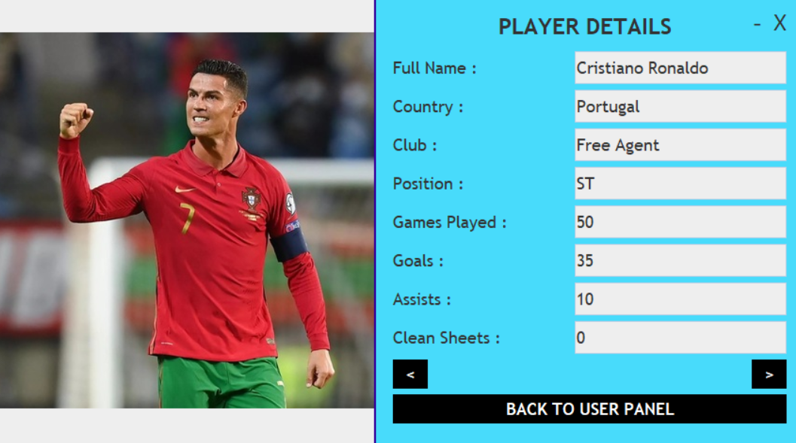
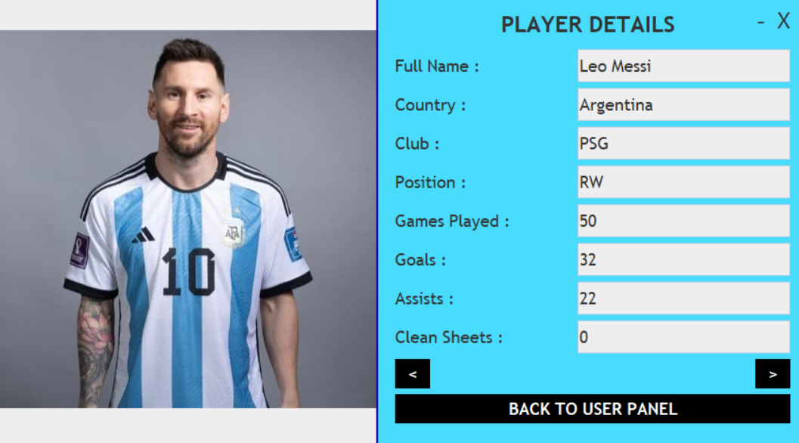
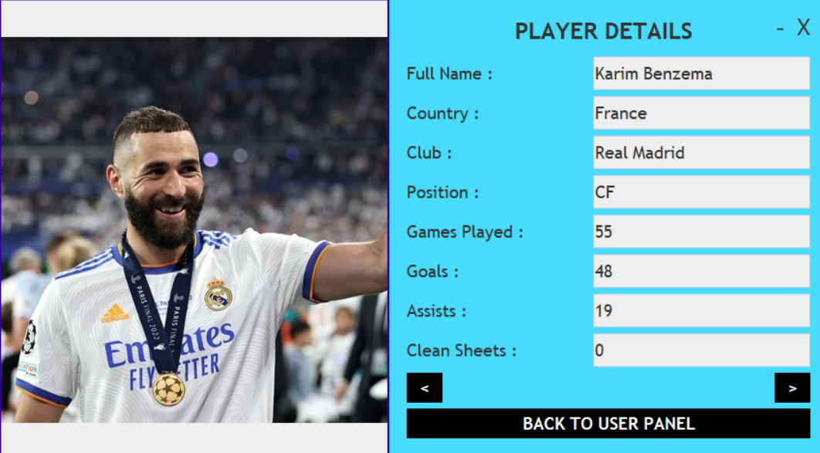
VIEW NOMINEES:

Slide 35
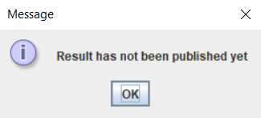
RESULTS:
Admin
Control
Admin
Control

Slide 36
RESULTS:
Player Data
Result Set

Slide 37
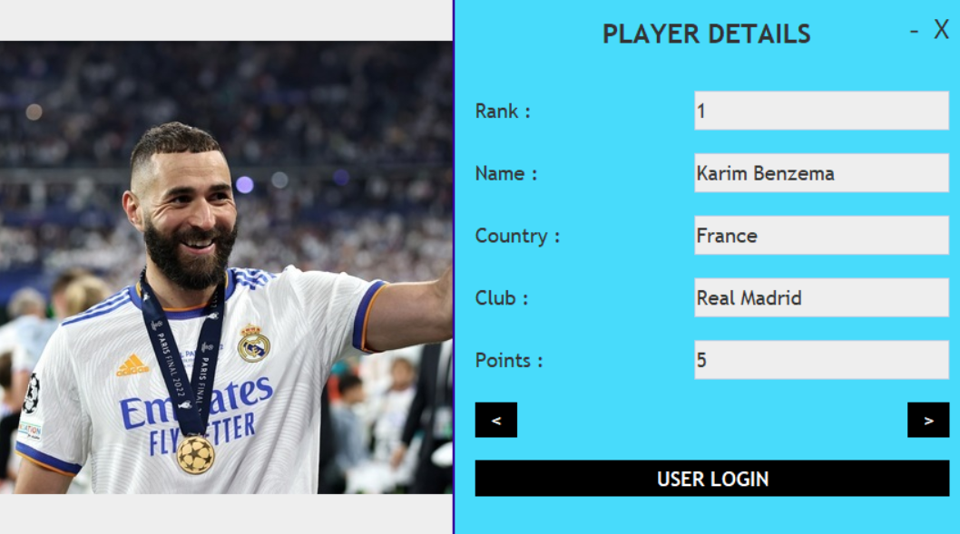
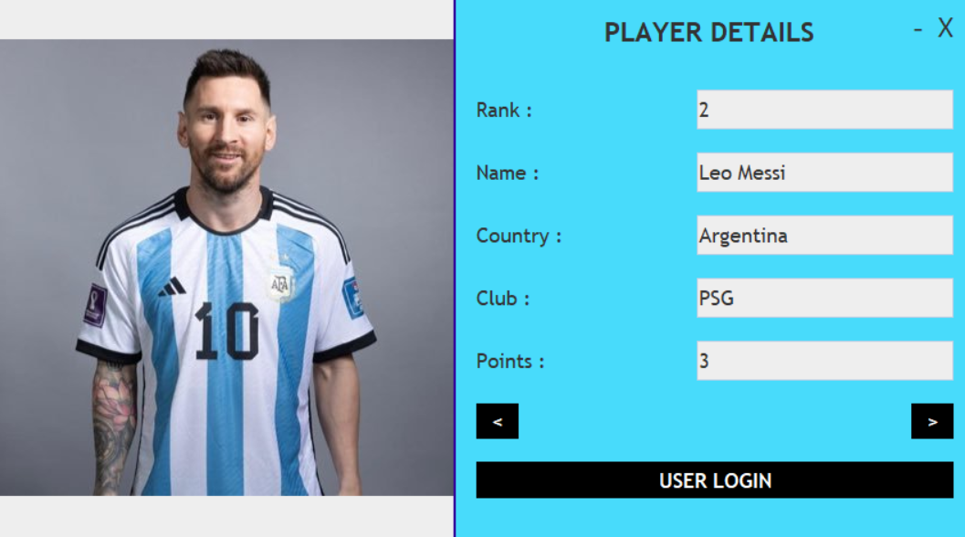
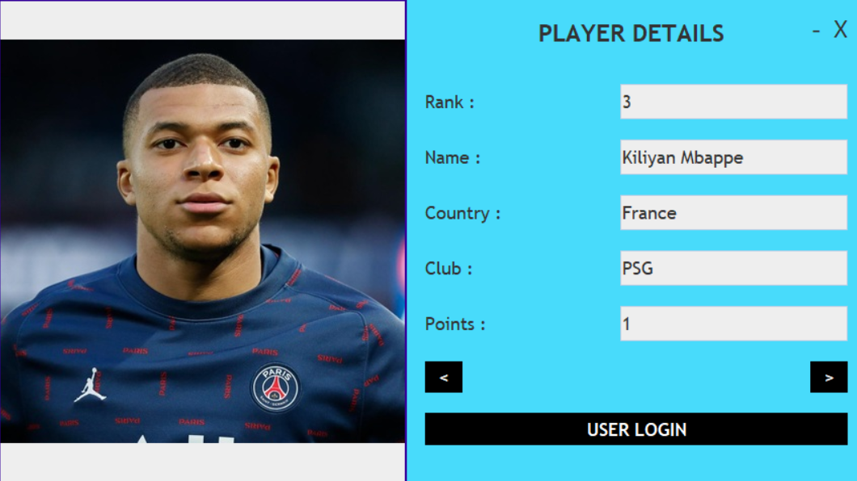
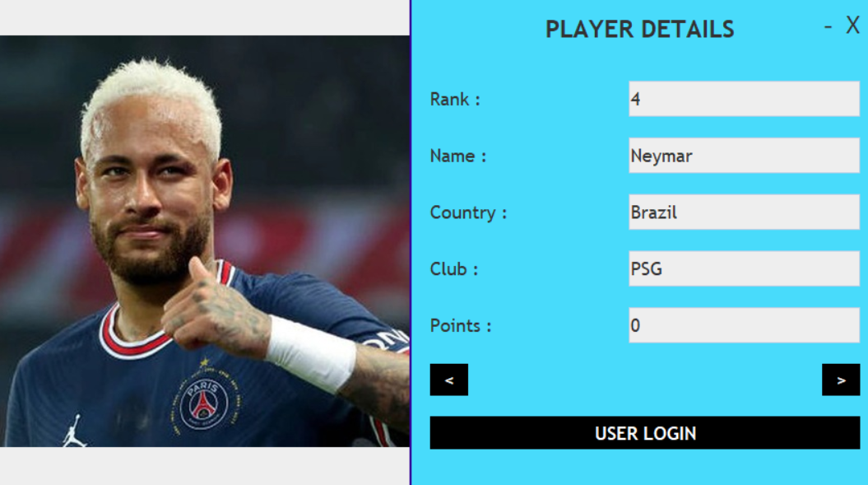
RESULTS:

Slide 38
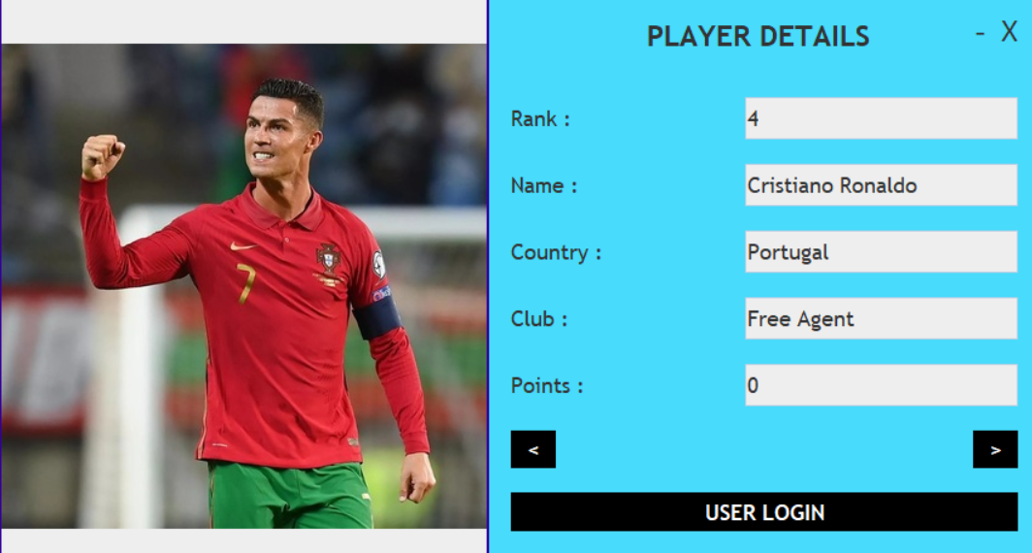
RESULTS (TIED POINTS):
Key Point:
Player with The Same Amount of Points will have The Same Rank

Slide 39
CONCLUSION:
Any type of Voting App can be created using this process
Database Manipulation is The Key Factor in the development of The App
JAVA Swing J-Panel Forms are used for easier development

Slide 40
REFERENCES:
www.javatpoint.com
www.stackoverflow.com
www.dev.mysql.com
www.youtube.com

Slide 41
THANK YOU

